Slide 1
TIN SMITHING & TINPUNCHING
GRADE 9 PBL

Slide 2
WHAT IS IT??
A tinsmith is a person who makes and repairs things made of light-coloured metal, particularly tinware. - - Wiki
Tin punching – an art that uses scraps of tin to create decorations.

Slide 3
EARLY HISTORY
Tin smithing was popular in England in the 1630s. Large sheets of tin were imported from Hamburg, Germany.
England began to produced large sheets of tin in the early 1700s, which they later exported to the American colonies.
The Pattersons, brothers from Ireland, opened the first tin smithing shop in Conneticut, USA in the early 1700s.

Slide 4
Beginning Stages in USA
No tin allowed to be milled until after the American Revolution.
Then the United States were able to produce tin themselves.
Peddlars would travel from village to village selling their wares.

Slide 5
Beginning Stages
Smithed decorated items that allowed light to pass through.
Tin was much cheaper than silver. It was also more durable, easier to clean, and lightweight.

Slide 6
Traditional Tinsmithed Items
Cups
Measuring spoons
Ladles
Cookie cutters
Plates
Kettles and coffee pots
Cupboard doors

Slide 7
Traditional candle

Slide 8
Traditional coffee pot

Slide 9
Traditional basin

Slide 10
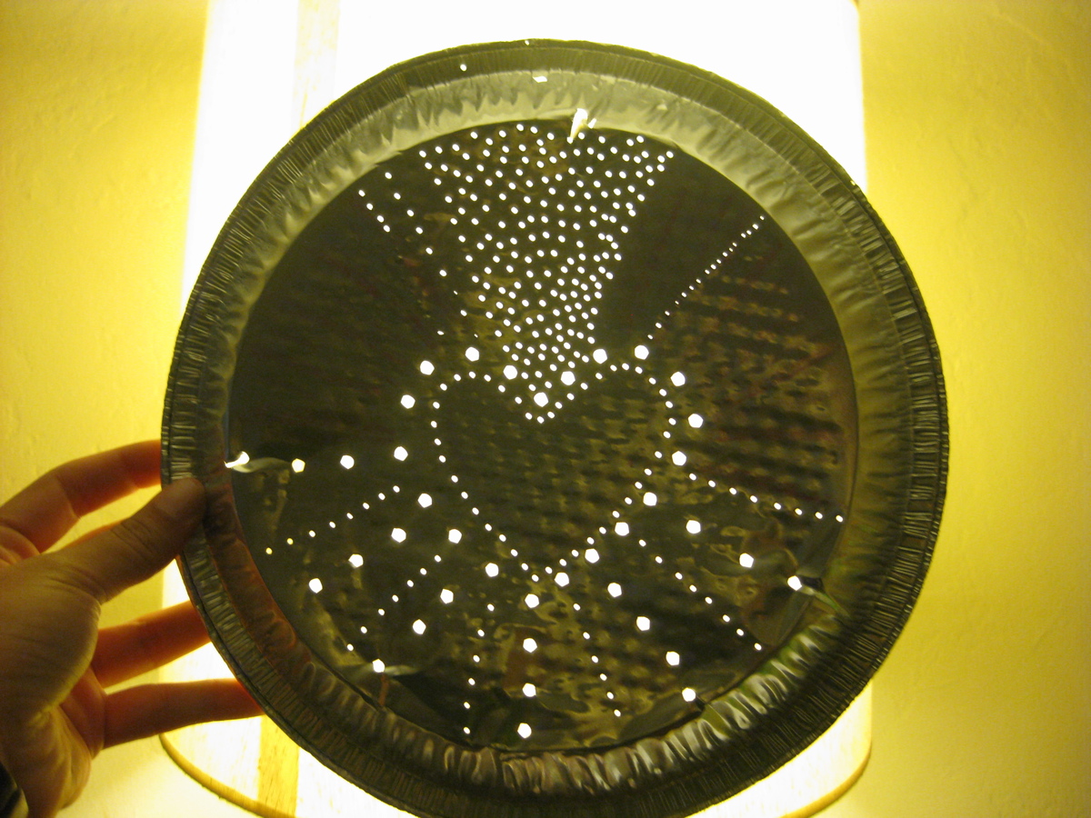
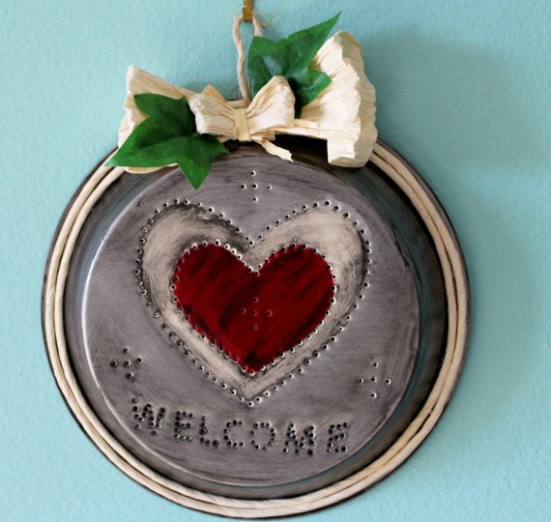
Modern tin punched items
Lanterns
Wall art
Candle holders
Vases

Slide 11
Modern wall decoration

Slide 12
Modern art

Slide 13
Modern lanterns

Slide 14
Steps to Tin Punching
Tin punching
Tin punch video
Tin punching slide show

